Slide 1

DEPARTMENT OF COMPUTER SCIENCE II Project Presentation (KCS 753) App: Chest X-ray Report Generator
Guide Name: Mr. Pawan Kumar Pal
1. Sujal Gupta 2000290120166/C
2. Vikas Yadav 2000290120190/C
3. Anmol Ratan 2100290128001/C

Slide 2

Problem Statement
Summarizing the X-ray in a form of radiology report is a complex task and more care should be taken in generating reports.
Radiology departments face challenges in efficiency due to manual generation of X-ray reports.
Manual generation of X-ray reports in radiology leads to time-consuming and error-prone processes.
Manual reports increase the risk of inaccuracies and misinterpretations.
Streamlining and automating this process is crucial to enhance efficiency and improve patient outcomes.

Slide 3
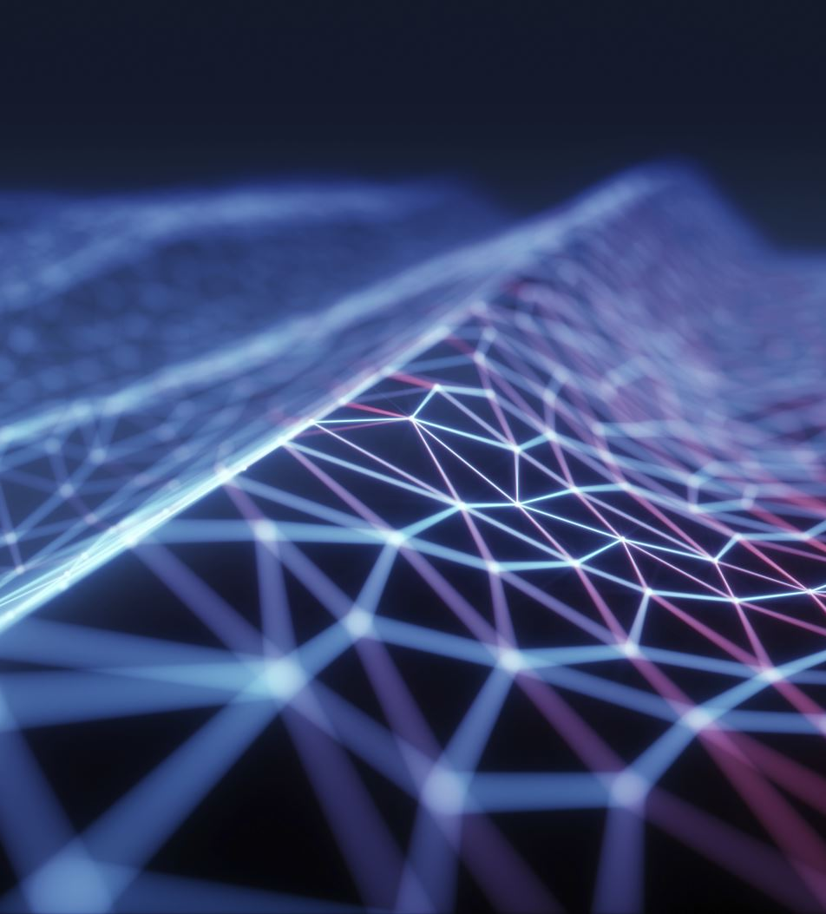
Objectives
The primary objective is to automate the process of generating X-ray reports, reducing the time and effort required by healthcare professionals to create them manually.
It will Increase the efficiency of radiologists and medical staff by providing a tool that can quickly generate accurate reports.
Automating report generation will produces reports that are accurate and consistent, reducing the likelihood of errors that can occur in manual reporting.
Develop a user-friendly and intuitive interface to make it easy to use the application without extensive training.

Slide 4
Technology Used
Front end
HTML/CSS
Python(Language)
Streamlit
Backend
Google Collab
Python
Pre-Trained Model (CheXNet)
Jupitor Notebook

Slide 5
Literature Survey
Title: “Diagnostic Captioning: a survey”
Author: John Pavlopoulos, Vasiliki Kougia, Ion Androutsopoulos and Dimitris Papamichail.
Journal: Springer
Year of publishing: 2022
Diagnostic captioning (DC) concerns the automatic generation of a diagnostic text from a set of medical images of a patient collected during an examination. DC can assist inexperienced physicians, reducing clinical errors. It can also help experienced physicians produce diagnostic reports faster. Following the advances of deep learning, especially in generic image captioning, DC has recently attracted more attention, leading to several systems and datasets. This article is an extensive overview of DC. It presents relevant datasets, evaluation measures, and up-to-date systems. It also highlights shortcomings that hinder DC’s progress and proposes future directions.

Slide 6
Title: ”Hierarchical X-Ray Report Generation via Pathology tags and Multi Head Attention”
Author: Preeti Srinivasan, Daksh Thapar
Journal: Springer
Year of publishing: 2020
For generating the report and tags, the proposed network learns to extract salient features of the image from a deep CNN and generates tag embeddings for each patient’s X-Ray images. We use transformers for learning self and cross attention. We encode the image and tag features with self-attention to get a finer representation. Use both the above features in cross attention with the input sequence to generate the report’s Findings. Then, cross attention is applied between the generated Findings and the input sequence to generate the report’s Impressions. We use a publicly available dataset to evaluate the proposed network.

Slide 7
Title: “On the Automatic Generation of Medical Imaging Reports”
Author: Baoyu Jing, Pengtao Xie and Eric P. Xing
Journal: Petuum Inc.
Year of publishing: 2018
First, a complete report contains multiple heterogeneous forms of information, including findings and tags. Second, abnormal regions in medical images are difficult to identify. Third, the reports are typically long, containing multiple sentences. To cope with these challenges, we (1) build a multi-task learning framework which jointly performs the prediction of tags and the generation of paragraphs, (2) propose a co-attention mechanism to localize regions containing abnormalities and generate narrations for them,(3) develop a hierarchical LSTM model to generate long paragraphs.

Slide 8
Title: ”Evaluating diagnostic content of AI-generated radiology reports of chest X-rays ”
Author: Zaheer Babar, Twan van Laarhoven, Fabio Massimo Zanzotto.
Journal: AI in medicine
Year of Publishing: 2021
Producing a well structured, clear, and clinically well-focused radiology report is essential for high-quality patient diagnosis and care. Despite recent advances in deep learning for image caption generation, this task remains highly challenging in a medical setting. Research has mainly focused on the design of tailored machine learning methods for this task, while little attention has been devoted to the development of evaluation metrics to assess the quality of AI-generated documents. Conventional quality metrics for natural language processing methods like the popular BLEU score, provide little information about the quality of the diagnostic content of AI-generated radiology reports.

Slide 9
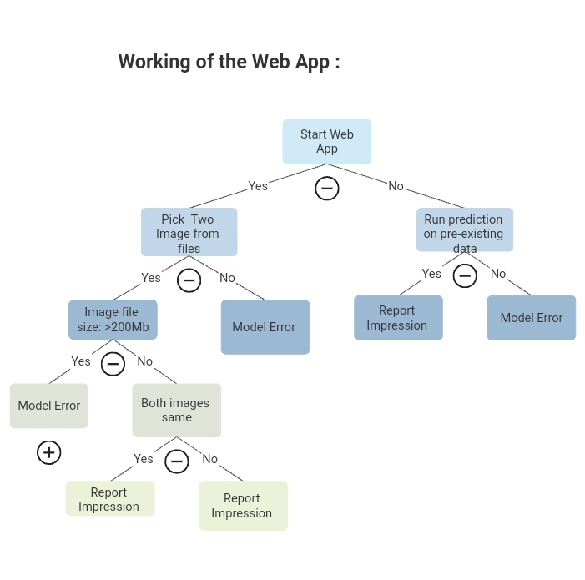

Slide 10
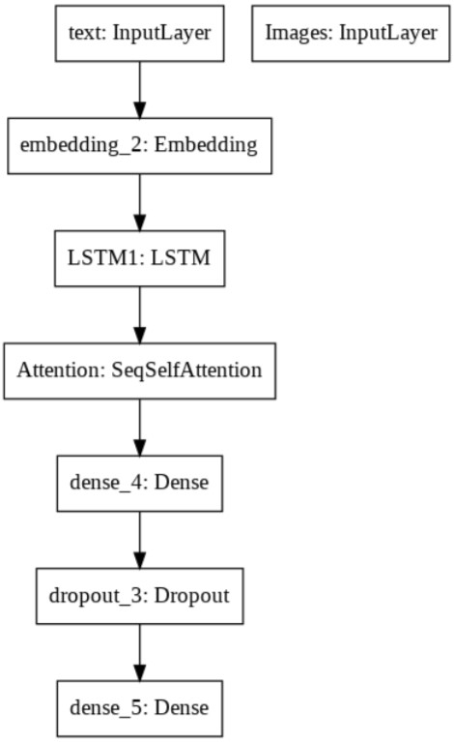
Process Flow Diagram

Slide 11
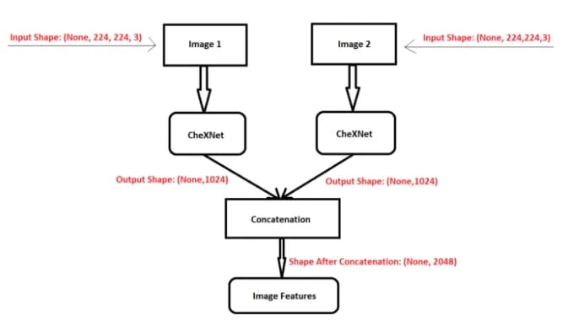

Slide 12
Research Paper Status
Completed Work:
Abstract
Introduction
Literature survey

Slide 13
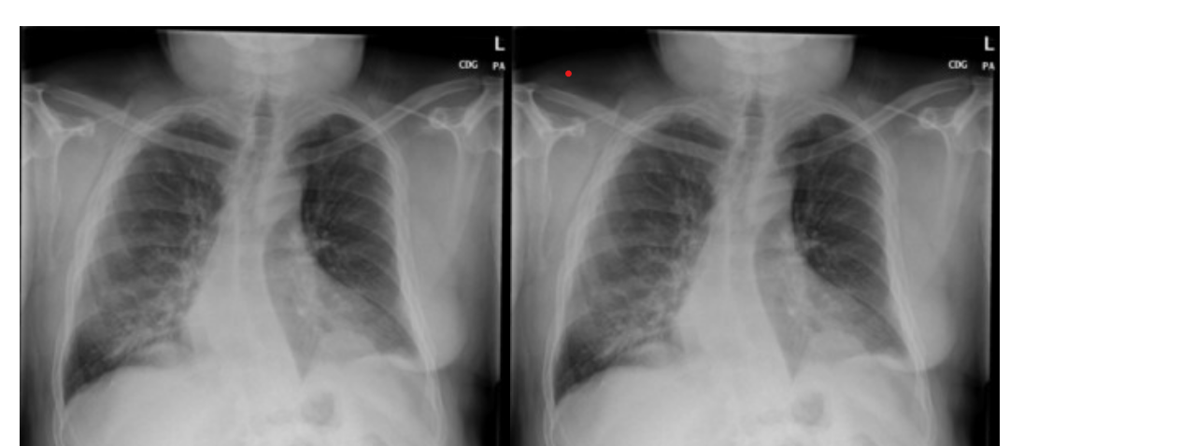
Output:

Slide 14
Report
Patent Draft:- Submitted
Testing Report:- Submitted

Slide 15
References
Lukaszewicz A, Uricchio J, Gerasymchuk G. The art of the radiology report: practical and stylistic guidelines for perfecting the conveyance of imaging findings.Can Assoc Radiol J 2016.
Xue Y, Xu T, Long LR, Xue Z, Antani S, Thoma GR, Huang X. Multimodal recurrent model with attention for automated radiology report generation. Proceedings of the international conference on medical image computing and computer-assisted intervention (MICCAI). Granada, Spain: Springer; 2018.
Jimmy Ba, Volodymyr Mnih, and Koray Kavukcuoglu.Multiple object recognition with visual attention. ICLR, 2015.
Razvan Pascanu, Caglar Gulcehre, Kyunghyun Cho, and Yoshua Bengio. How to construct deep recurrent neural networks. ICLR, 2014.
Aerts HJ, Velazquez ER, Leijenaar RT, Parmar C, Grossmann P, Carvalho S, Bussink J, Monshouwer R, Haibe-Kains B, Rietveld D et al (2014) Decoding tumour phenotype by noninvasive imaging using a quantitative radiomics approach.

Slide 16

Nat Commun 5:1–92. Agrawal H, Desai K, Wang Y, Chen X, Jain R, Johnson M, Batra D, Parikh D, Lee S, Anderson P(2019) nocaps: novel object captioning at scale. In: Proceedings of the IEEE international conference on computer vision, Seoul, Korea, pp 8948–8957
3. Anderson P, Fernando B, Johnson M, Gould S (2016) SPICE: semantic propositional image caption evaluation. In: Proceedings of the European conference on computer vision, Amsterdam, Netherlands, pp 382–398
Jing, B., Xie, P., Xing, E.: On the automatic generation of medical imaging reports.
ACL (2018)
3. Wang, X., Peng, Y., Lu, L., Lu, Z., Summers, R.M.: Tienet: Text-image embedding
network for common thorax disease classification and reporting in chest x-rays. In: Proceedings of the IEEE conference on computer vision and pattern recognition. (2018) 9049–9058
4. Johnson, J., Karpathy, A., Fei-Fei, L.: Densecap: Fully convolutional localization networks for dense captioning. In: Proceedings of the IEEE Conference on Computer Vision and Pattern Recognition. (2016)

